Slide 1
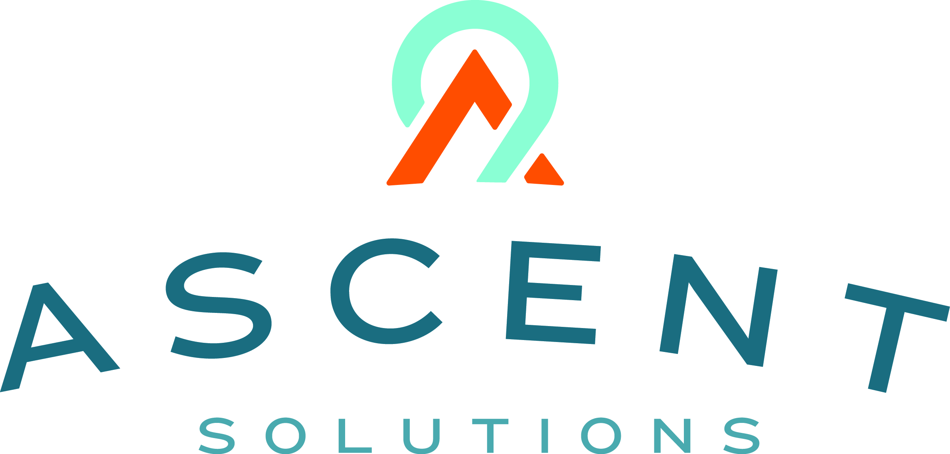

Content: aka.ms/omahadevdays
Survey: aka.ms/ncrdevdayssurvey
#Azuredevdays

Slide 2
Containers and Microservices
Greg Hoelzer
Azure App Dev Tech Specialist

Slide 3
Balancing IT and business
72%
Rapid innovation to transform products
Changing security and compliance requirements
of IT budgets are dedicated towards maintenance (“keeping the lights on”)
Connect with customers and empower employees
IT challenges
Business needs

Slide 4
The journey to the cloud
Apps
Data & Intelligence
Migration & Modernization
Cloud-Native
SaaS
On-premises
Rehost
Refactor
Rearchitect
Rebuild/New
Replace
Infrastructure
DevOps
Deliver faster and more reliably

Slide 5
Cloud app continuum
SaaS apps
Serverless
Replace
Microservices
Rebuild New
Engineering Complexity and Cost
Containers
Rearchitect
VMs
Refactor
Existing on-premises applications
Rehost
App Modernization
Agility – Time to Market – Total Cost of Ownership – IT Simplification

Slide 6
What is a container?
Containers = operating system virtualization
Traditional virtual machines = hardware virtualization
OS
Application
VM
VM
VM
Applications
Container
Container
Container
App
App
App
Kernel
OS
OS
OS
OS
Hardware
Hardware
@christi3k @zdeptawa

Slide 7
The container advantage
Traditional virtualized environment
VM
VM
Low utilization of container resources
Containerization of applications and their dependencies
Con.
Con.
Con.
Con.
Hypervisor 2
Host OS
Hardware
@christi3k @zdeptawa

Slide 8
The container advantage
Containerized environment
Migrate containers and their dependencies to underutilized VMs for improved density and isolation
VM
VM
Con.
Con.
Decommission unused resources for efficiency gains and cost savings
Con.
Con.
Docker Engine
Host OS
Hardware
@christi3k @zdeptawa

Slide 9
How can containers help your app modernization journey?
From traditional systems to a portfolio of modern apps
App
Container
App
Existing/New Applications
Lift and shift to containers
Each host often runs 8 containers at a time¹
Microservices
Seconds to deploy, churns 12x faster¹
Continuous innovation with DevOps
46x more frequent for code delivery²
1: Datadog Report: 8 Surprising Facts About Real Docker Adoption; 2: 2017 state of DevOps Report

Slide 10
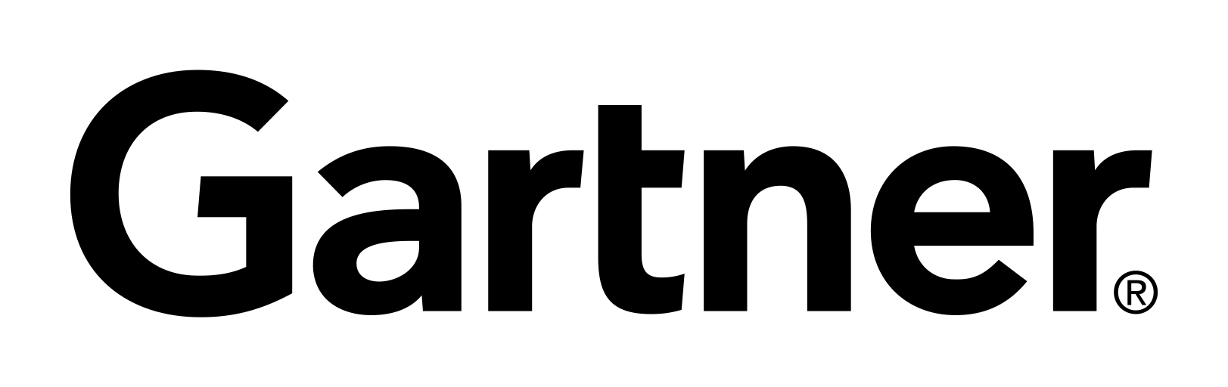
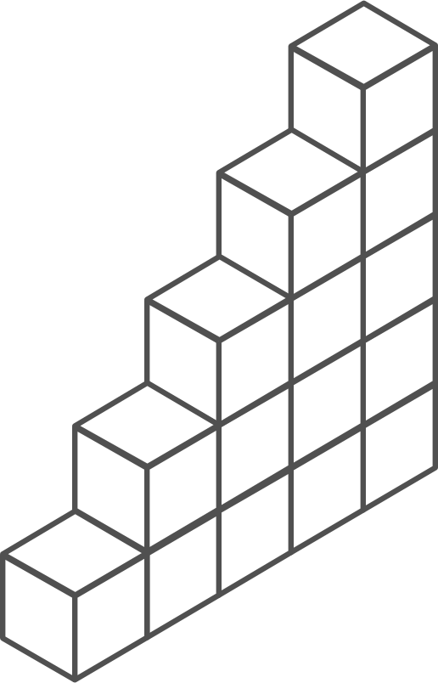
Containers momentum
“By 2020, more than 50% of enterprises will run mission-critical, containerized cloud-native applications in production.”
Half of container environment is orchestrated.¹
77%
77% of companies² who use container orchestrators choose Kubernetes.
The average size of a container deployment has grown 75% in one year. ¹
Larger companies are leading the adoption.¹
75%
50%
Nearly 50% of organizations¹ running 1000 or more hosts have adopted containers.
¹ Datadog report: 8 Surprising Facts About Real Docker Adoption
² CNCF survey: cloud-native-technologies-scaling-production-applications

Slide 11
What we hear from developers
I need to create applications at a competitive rate without worrying about IT
New applications run smoothly on my machine but malfunction on traditional IT servers
My productivity and application innovation become suspended when I have to wait on IT
@christi3k @zdeptawa

Slide 12
What we hear from IT
I need to manage servers and maintain compliance with little disruption
I’m unsure of how to integrate unfamiliar applications, and I require help from developers
I’m unable to focus on both server protection and application compliance
@christi3k @zdeptawa

Slide 13
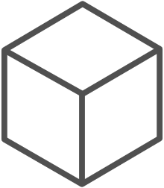
The container win-win
Fast iteration
Agile delivery
Immutability
Cost savings
Efficient deployment
Elastic bursting
For developers
For IT
@christi3k @zdeptawa

Slide 14
Demo
Getting started with containers
Notes:
Demo: Add container support to ASP.NET Core application using Visual Studio 2017 or
https://docs.microsoft.com/en-us/azure/aks/tutorial-kubernetes-prepare-app

Slide 15



What are microservices?
A Software Architectural Style
Monolithic
Microservices
Applications are composed of small, independent modules that communicate with each other using well-defined APIs. Not platform specific.
Large, all-inclusive app
Small, independent services
App
App
App
Decoupled
These service modules are highly decoupled building blocks that are small enough to implement a single functionality but together can form larger systems
Independently versioned, deployed & scaled
With a microservices architecture, developers can create, manage and improve application services independently, even using different languages
Containers provide the consistent format and isolation desired by microservices.

Slide 16
Microservices: Benefits
Encapsulates business functionality into small targeted services, organized around business capabilities
Services deploy frequently and evolve independently
Services scale Independently
Enables technology diversity
Mix multiple programming platforms and data-storage technologies—best tool for the job
Rewriting/modernizing a single service is feasible
“Future-proofs” application investment against obsolete technology stacks
Failure in one service less likely to cause system-wide failure

Slide 17
Microservices: Challenges
No free lunch…
Architectural and operational complexity increase
Remote calls escalate network I/O, congestion and latency
Distributed services expose points of failure, reducing reliability
Decentralized data require eventual consistency delays
Integration and versioning concerns become critical
Service discovery and routing concerns must be handled
Testing—stubs/mocks become key
Orchestration, management, and monitoring are mandatory

Slide 18
Microservice candidates
Most solutions do not warrant a microservices architecture
Consider microservices, when…
Large, strategic enterprise systems that need to align business capabilities/features
Systems that require a high release velocity: Frequent feature releases with high confidence
Applications developed by heterogenous teams with expertise in different technology stacks – Polyglot languages and tools
Application with components that must scale independently

Slide 19
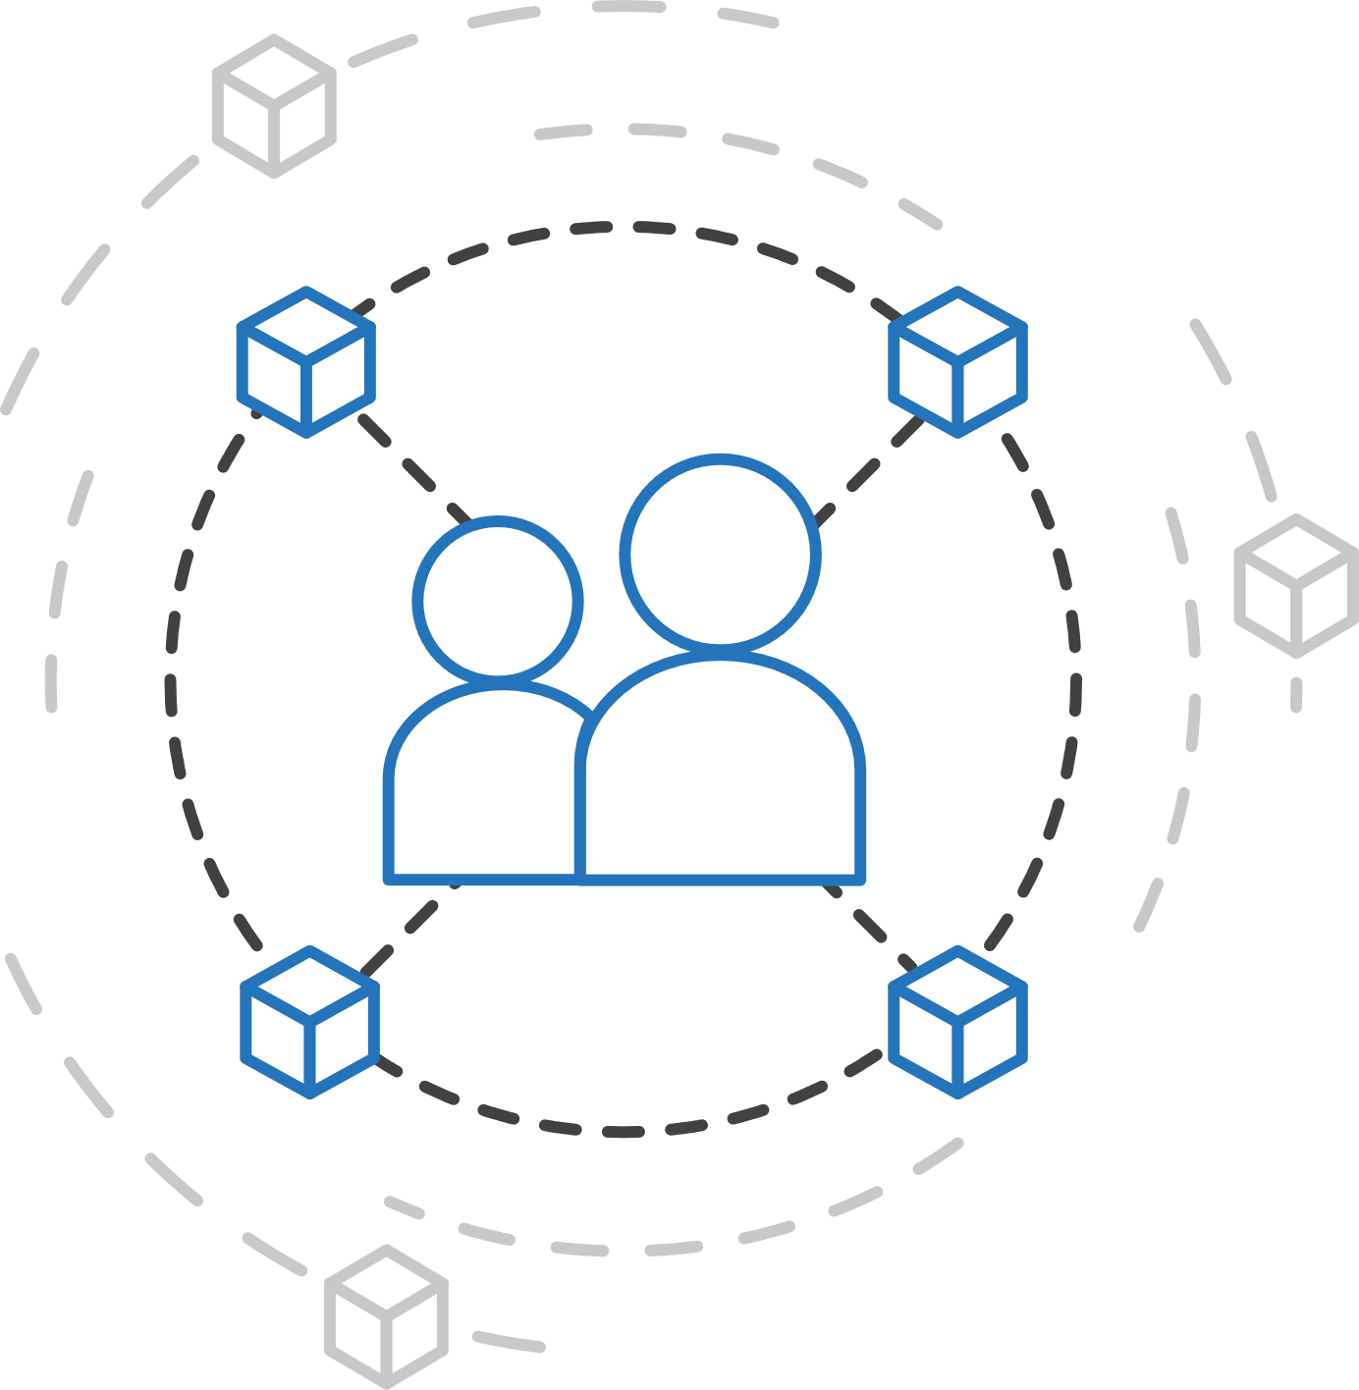
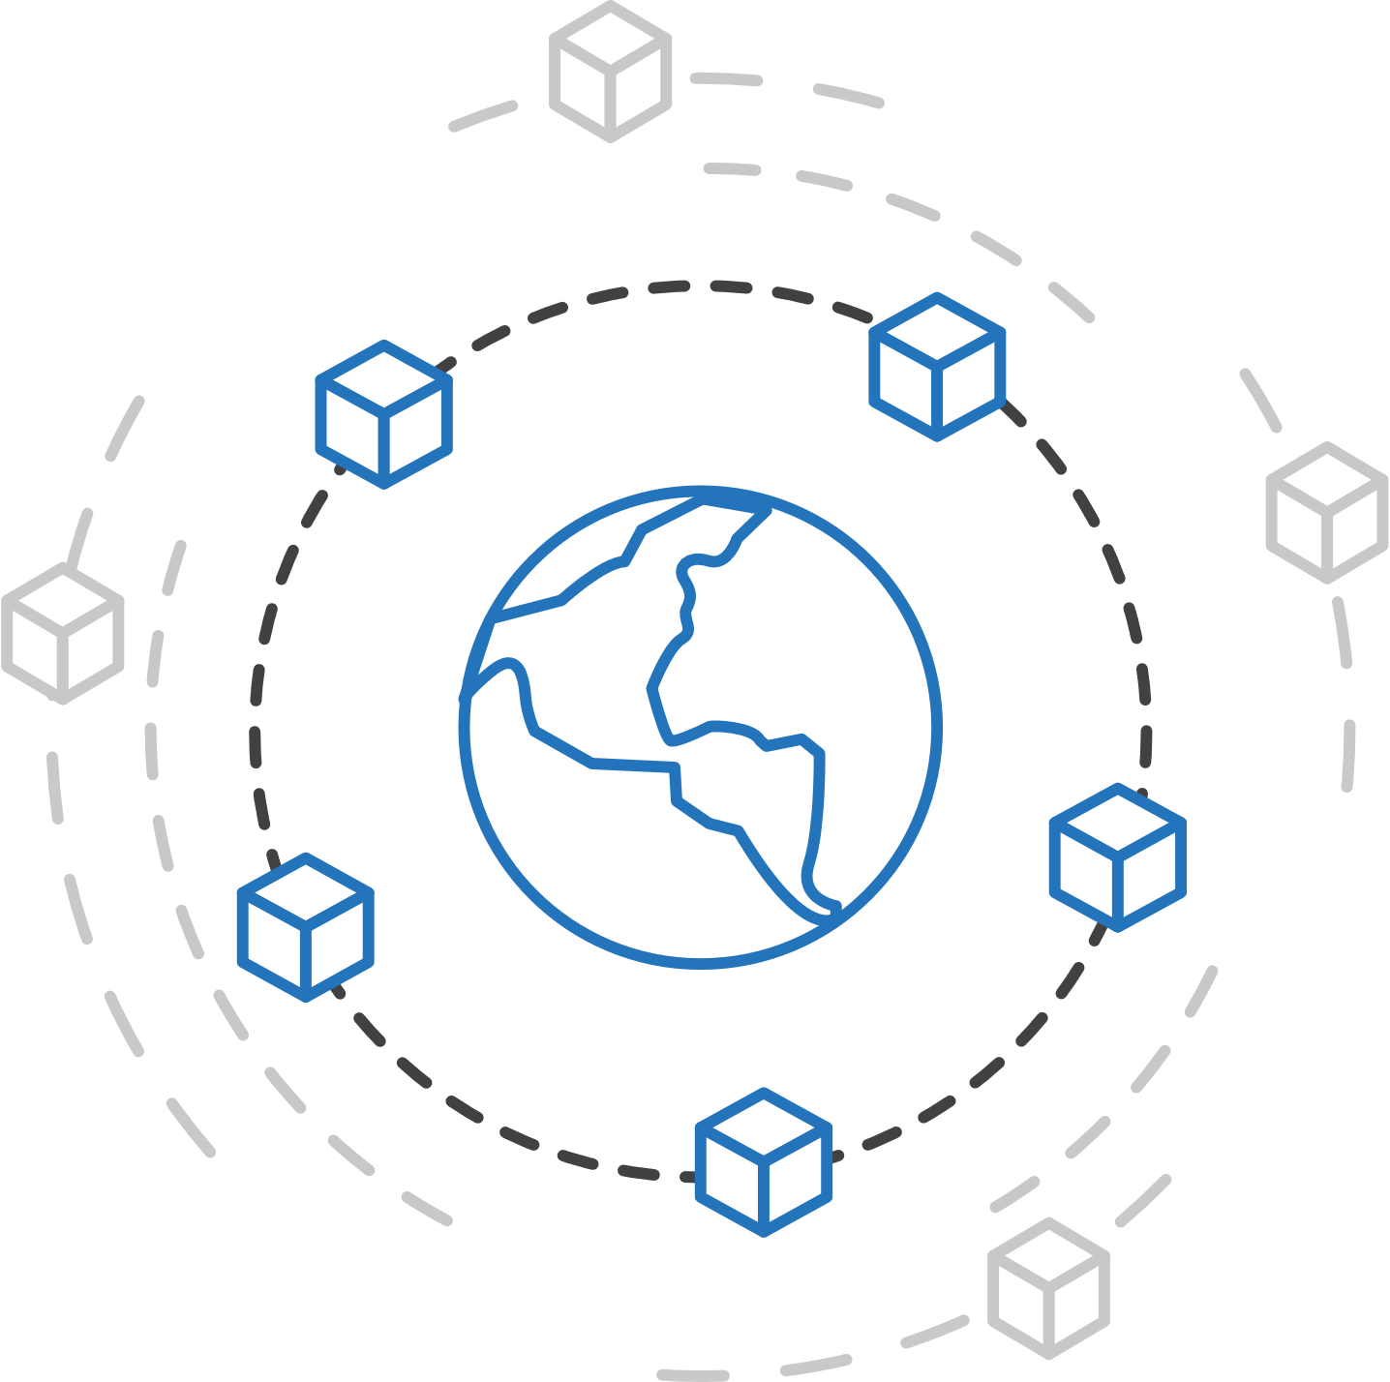
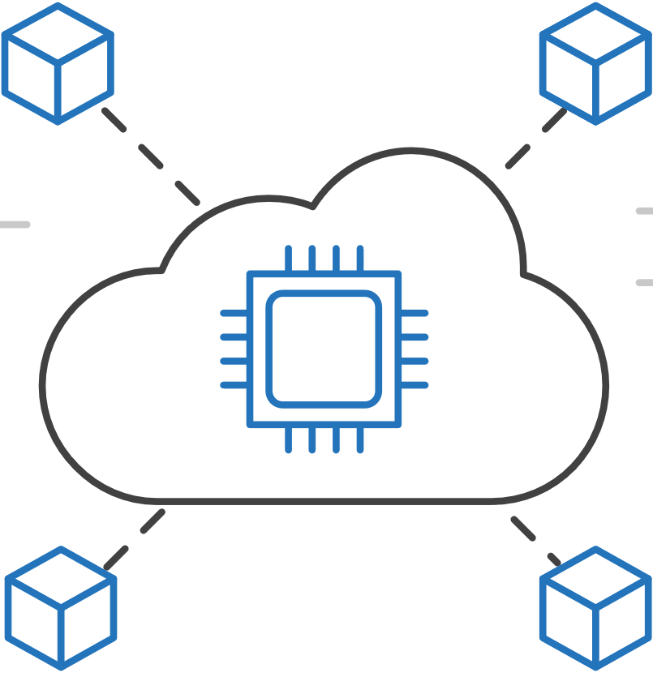
How Azure helps
Flexibility
Productivity
Trust
Deploy containerized applications in your preferred environment
Accelerate containerized application development
Manage, monitor, and secure your containers easily

Slide 20

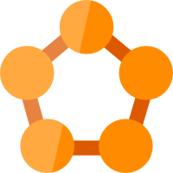

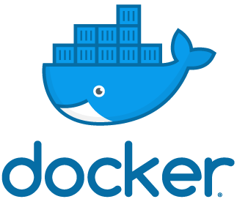



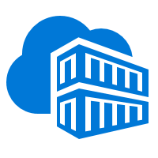
Containers in Azure
App Service
Service Fabric
Kubernetes Service
Container Instance
Ecosystem
Deploy web apps or APIs using containers in a PaaS environment
Modernize .NET applications to microservices using Windows Server containers
Scale and orchestrate Linux containers using Kubernetes
Elastically burst from your Azure Kubernetes Service (AKS) cluster
Bring your Partner solutions that run great on Azure
Azure Container Registry
Docker Hub
Choice of developer tools and clients

Slide 21
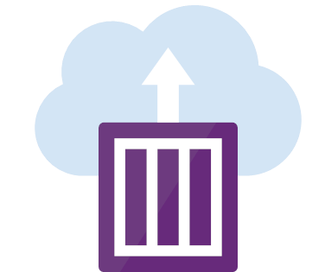
Azure Container Instances (ACI)
Easily deploy and run containers with a single command
Launch container instances in seconds
Cost effective per second billing
Notes:
https://docs.microsoft.com/en-us/azure/container-instances/container-instances-quickstart

Slide 22
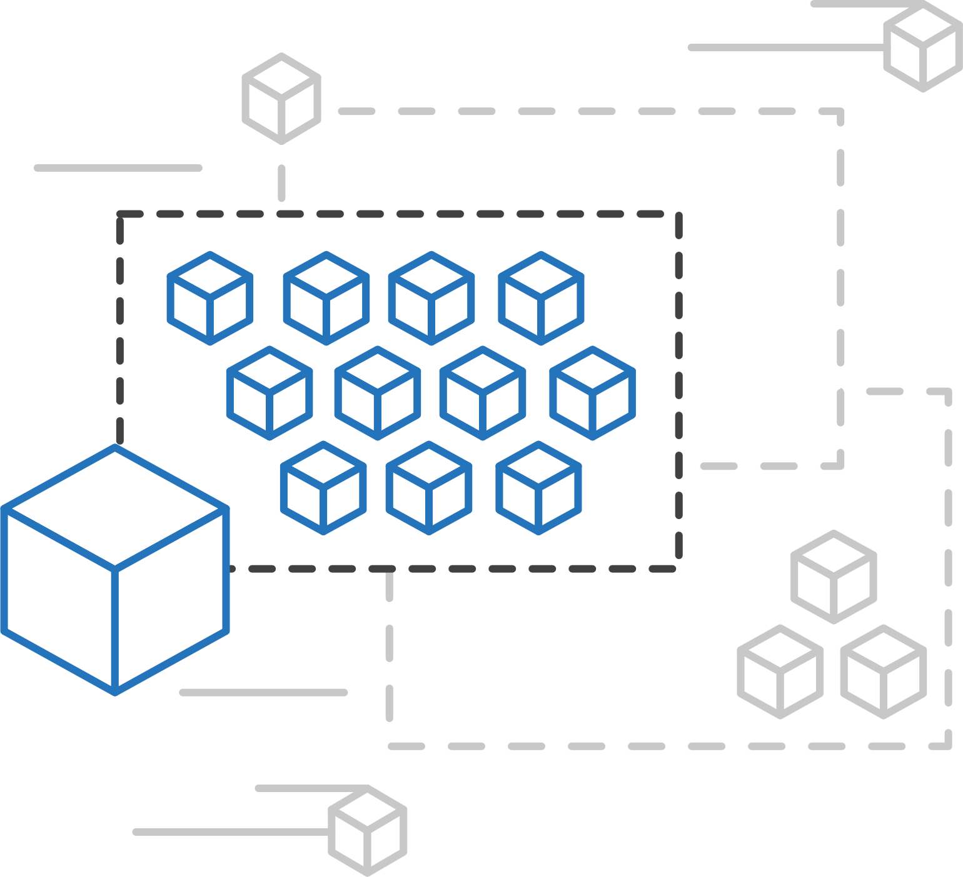
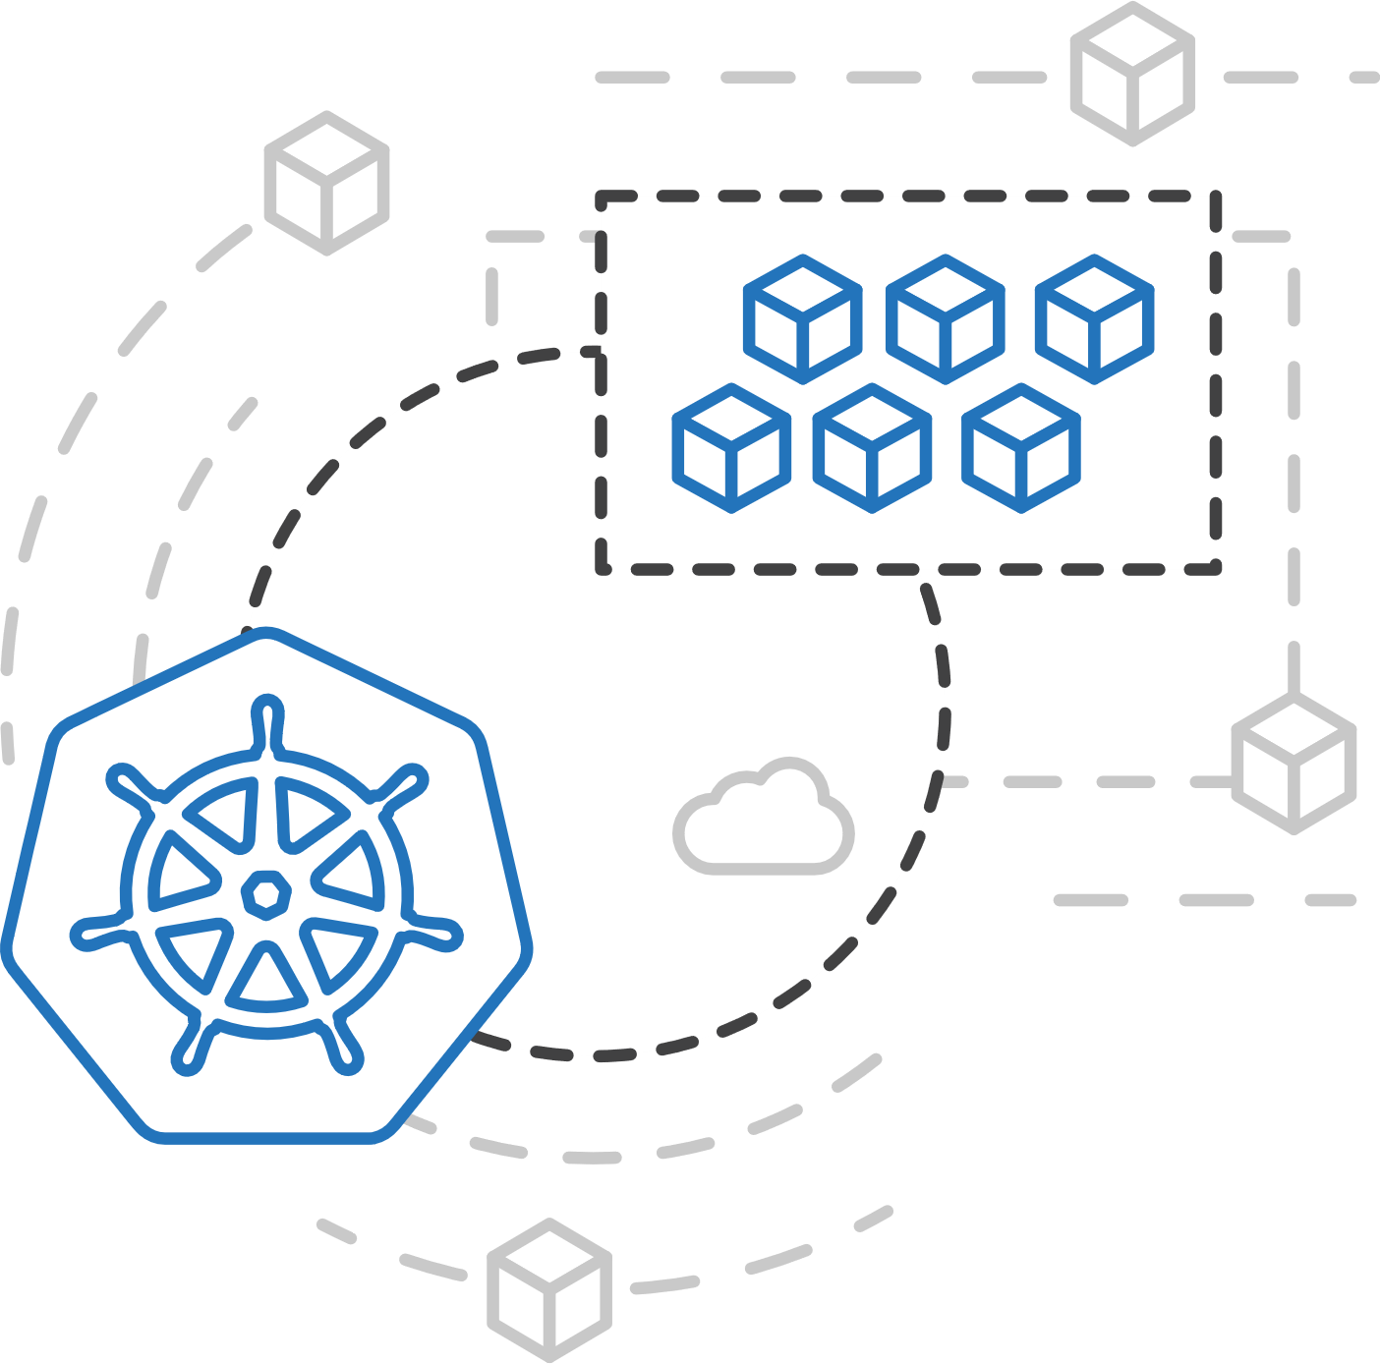
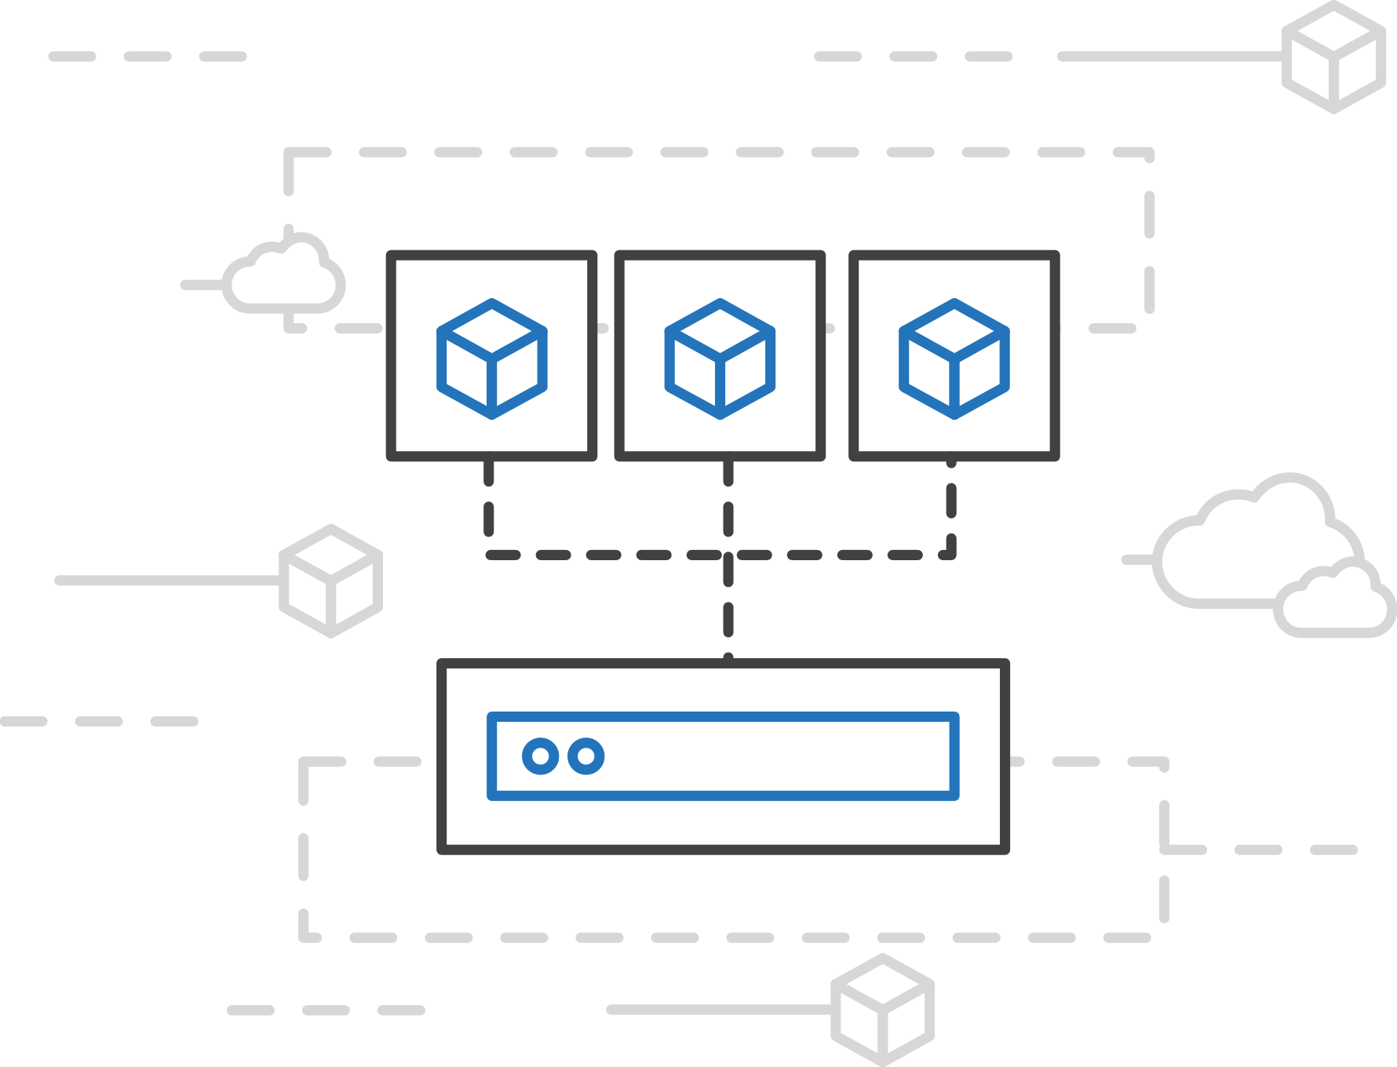
Azure Container Instances (ACI)
Easily run containers on demand without managing servers
Run containers without managing servers
Increase infrastructure agility with containers on demand
Secure applications with hypervisor isolation

Slide 23
Demo
Spinning up a container using ACI
Notes:
Demo ACI: https://docs.microsoft.com/en-us/azure/container-instances/container-instances-quickstart-portal

Slide 24
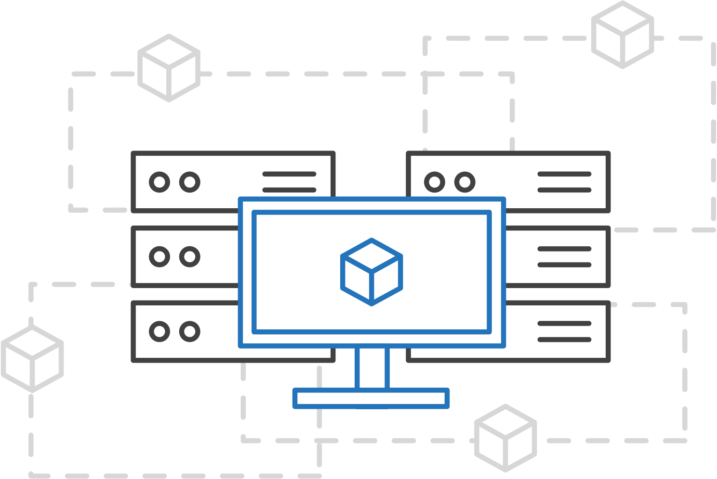
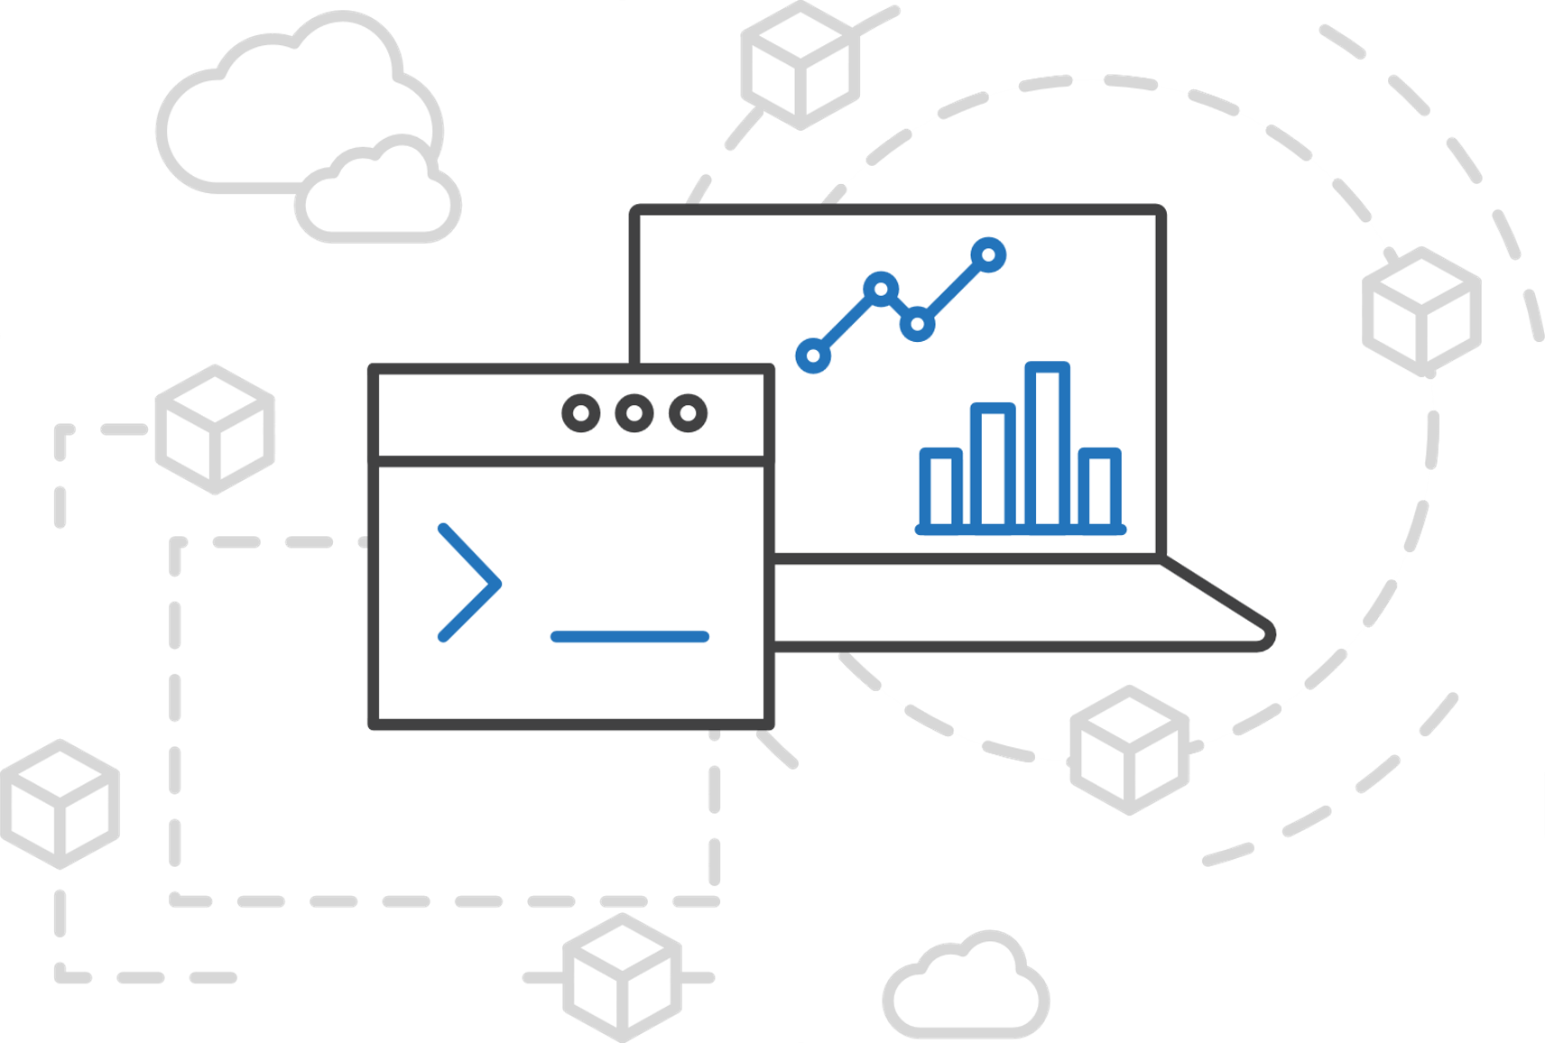
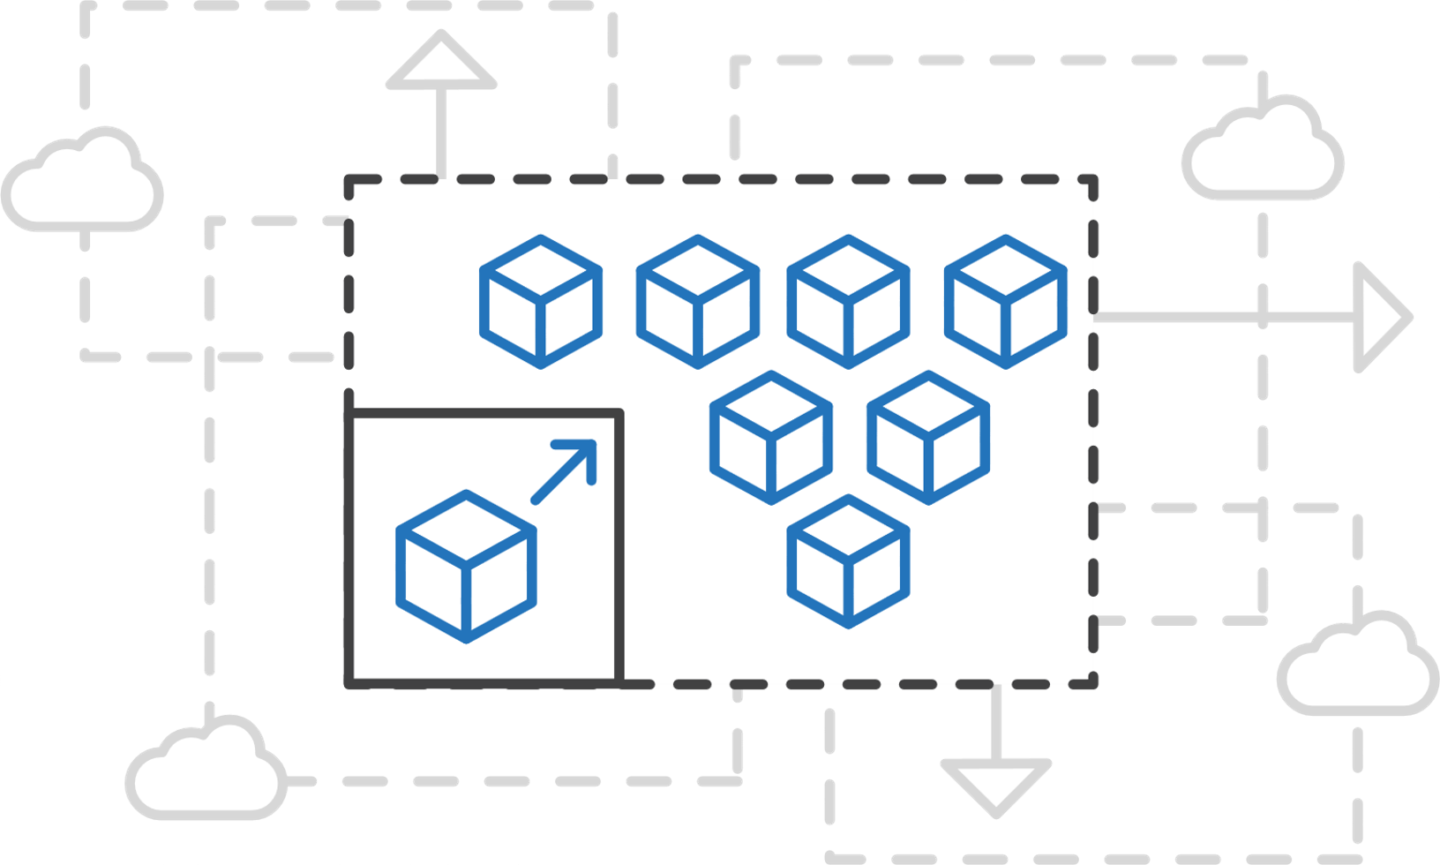
Azure Kubernetes Service (AKS)
Simplify the deployment, management, and operations of Kubernetes
Focus on your containers not the infrastructure
Work how you want with open-source APIs
Scale and run applications with confidence

Slide 25
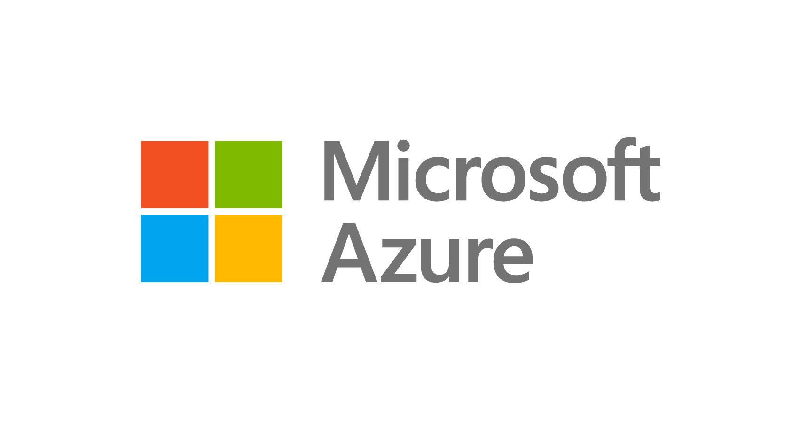
Azure Kubernetes Service (AKS)
A fully managed Kubernetes cluster
Managed control pane
Automated upgrades, patches
Easy cluster scaling
Self-healing
Cost savings
Managed
Application architect
Applications
Operations
Kubernetes
Infrastructure architect
Docker
Azure infrastructure services

Slide 26
Azure Kubernetes Service (AKS)
Get started easily
$ az aks create -g myResourceGroup -n myCluster --generate-ssh-keys
\ Running ..
$ az aks install-cli
Downloading client to /usr/local/bin/kubectl ..
$ az aks get-credentials -g myResourceGroup -n myCluster
Merged "myCluster" as current context ..
$ kubectl get nodes
NAME STATUS AGE VERSION
aks-mycluster-36851231-0 Ready 4m v1.8.1
aks-mycluster-36851231-1 Ready 4m v1.8.1
aks-mycluster-36851231-2 Ready 4m v1.8.1

Slide 27
Azure Kubernetes Service (AKS)
Manage an AKS cluster
$ az aks list –o table
Name Location ResourceGroup KubernetesRelease ProvisioningState
------------------ ---------- -------------- ------------------- -------------------
myCluster westus2 myResourceGroup 1.7.7 Succeeded
$ az aks upgrade -g myResourceGroup -n myCluster –-kubernetes-version 1.8.1
\ Running ..
$ kubectl get nodes
NAME STATUS AGE VERSION
aks-mycluster-36851231-0 Ready 12m v1.8.1
aks-mycluster-36851231-1 Ready 8m v1.8.1
aks-mycluster-36851231-2 Ready 3m v1.8.1
$ az aks scale -g myResourceGroup -n myCluster --agent-count 10
\ Running ..

Slide 28
Demo
Deploy containers on AKS
Notes:
Demo: https://docs.microsoft.com/en-us/azure/aks/kubernetes-walkthrough

Slide 29


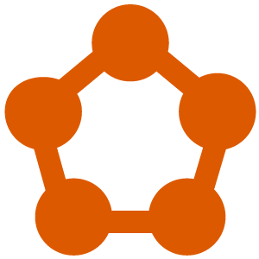
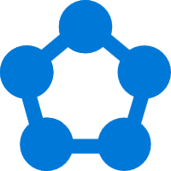





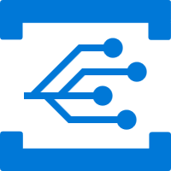

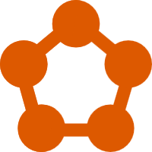
Powering Azure and Microsoft services
Service Fabric is designed for mission-critical services
Azure Database for MySQL
SQL Database
Power BI
Cosmos DB
Azure Monitor
Azure Database for PostgreSQL
Core Azure Services
Azure Container Registry
Dynamics
IoT Hub
Intune
Event Hub
Archive Storage
Event Grid
Cortana
Skype
Visual Studio Team Services
Stream Analytics
Service Fabric

Slide 30

Azure Service Fabric Offerings
Dev machine
Any cloud
On-premises
Service Fabric Standalone
Azure
Service Fabric
Azure
Service Fabric Mesh
Bring your own infrastructure
Dedicated Azure clusters
Serverless microservices
Full Control
Fully managed
Service Fabric

Slide 31


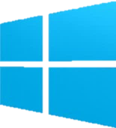

Azure Service Fabric Mesh
A Serverless microservices platform for business critical applications
Microservices development
Serverless infrastructure
Scale on demand
</>
.NET
</>
Lifecycle management
Pay only for what you use
Intelligent traffic routing
Microservice and container orchestration
Security & compliance
Health & monitoring
Service Fabric Mesh

Slide 32


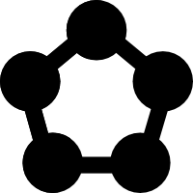

Modernize .NET application with Service Fabric
Polyglot services, described by resources
Deploy anything and everything in a container
Bring your own network to connect to other systems
No code changes required
No servers or VMs to manage with Service Fabric Mesh
Enhanced with Reliable Collections and volume drives for state
Connected through intelligent routing
Service
Service
Internet
Service
Auto Scaling
Volumes
Routing
Reliable Collections
Secrets
Dev machine
Any cloud
On-prem
Azure clusters
Mesh

Slide 33
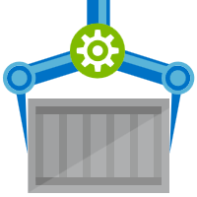


Release Management
Resource Pool
Orchestration
HOST-A
Deploy:
web:1 x3
quotes:1 x3
important:1 x4
Image Cache
3
web:1
digest: 91e
web:1
digest: 91e
Foo:
web:1 x3
quotes:1 x3
important:1 x4
web:1
digest: 91e
quotes:1
digest: u82
Container Builder
important:1
digest: 2re
important:1
digest: 2re
Container Registry
HOST-B
Image Cache
quotes:1
digest: u82
quotes:1
digest: u82
7
6
quotes:1
digest: u82
5
web:1
digest: 91e
important:1
digest: 2re
important:1
digest: 2re
important:1
digest: 2re
quotes:1
digest: u82
1
quotes:1
digest: u82
docker build –t web:1
docker build –t quotes:1
docker build –t important:1
docker push web:1
docker push quotes:1
docker push important:1
important:1
digest: 2re
important:1
digest: 2re
Image
web:1
quotes:1
important:1
2
Digests
91e
u82
2re
web:1
digest: 91e
HOST-C
quotes:1
digest: u82
4
important:1
digest: 2re
8
Image Cache
quotes:1
digest: u82
quotes:1
digest: u82
important:1
digest: 2re
important:1
digest: 2re

Slide 34

Thank You!
Please fill out survey

